Slide 1

RAHAT
Remote Application for Health Assistance And Tracking

Slide 2
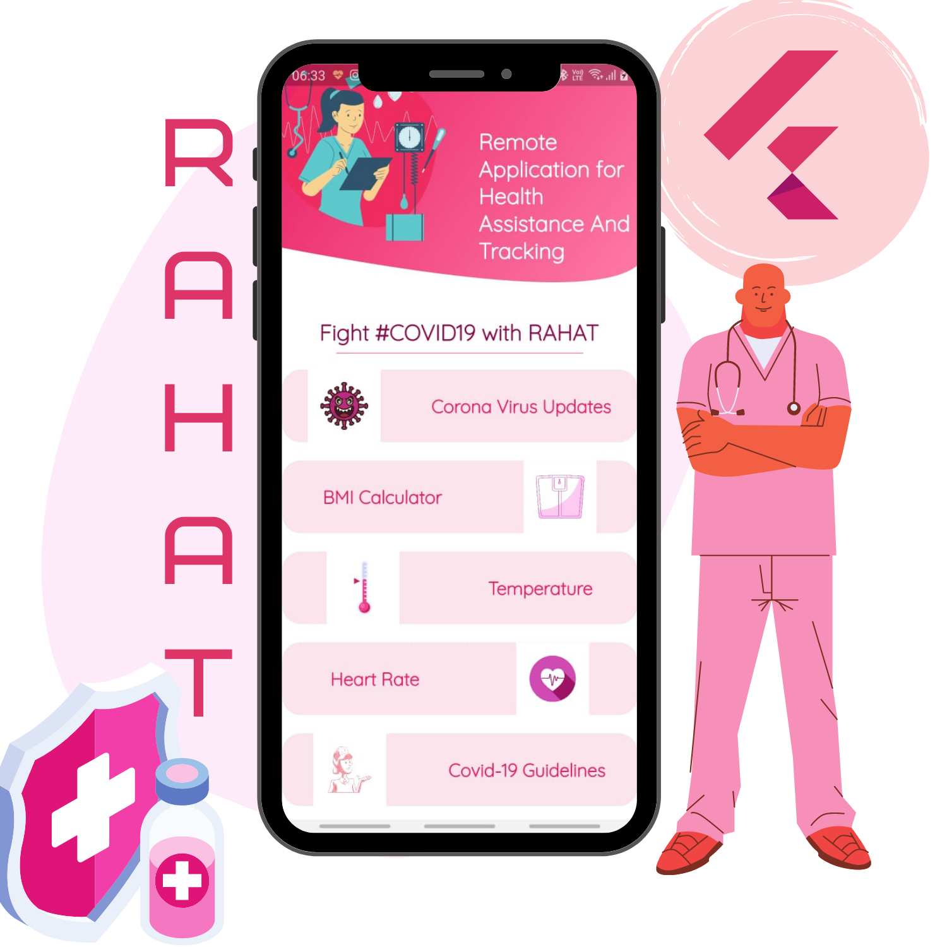
Developed by Team 220 Volts
Kanav Bhasin (Email: kanavbhasin22@gmail.com)
Daksh Nauni (Email: mr.codefrost@gmail.com)
Yakshit Gupta (Email: guptayakshit@gmail.com)
Theme: Healthcare
Problem: Lack of Remote Health Tracking

Slide 3
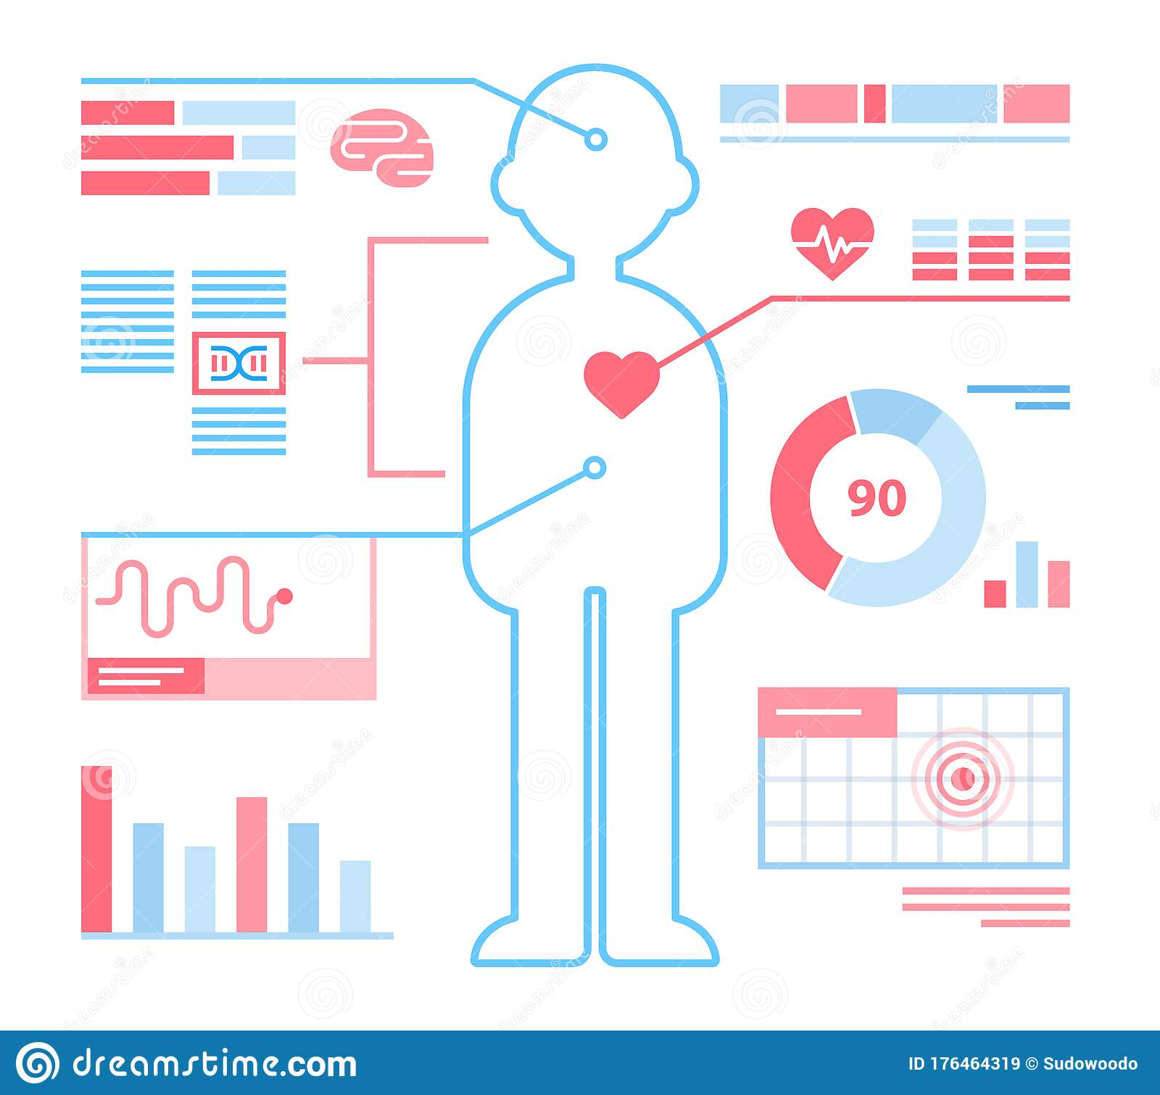
What is RAHAT?
RAHAT is software-hardware project developed for Health Tracking and Assistance of remote users.

Slide 4
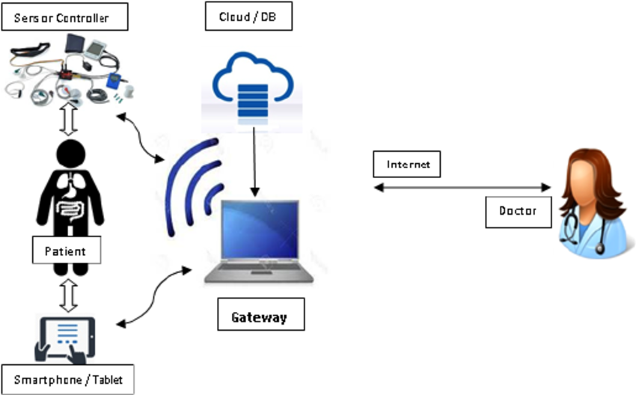
How does it work?
RAHAT implements sensor technology, internet and flutter application to track user’s health data

Slide 5
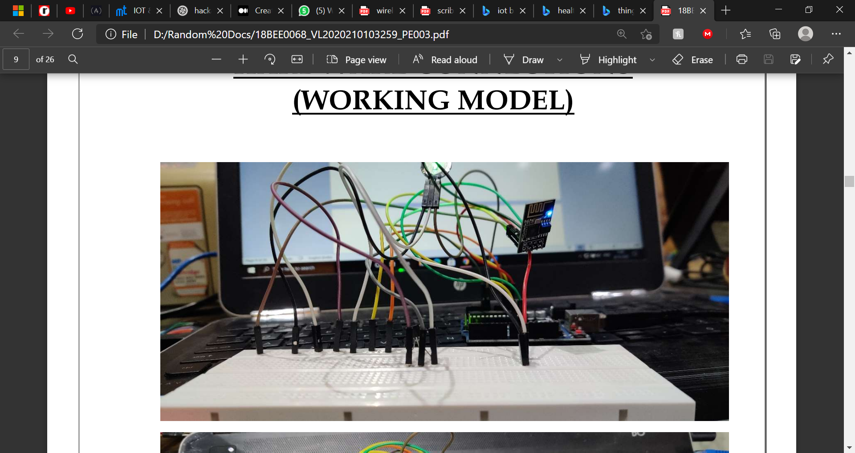
How does it work?
The Hardware ( to be worn like a band/watch)

Slide 6
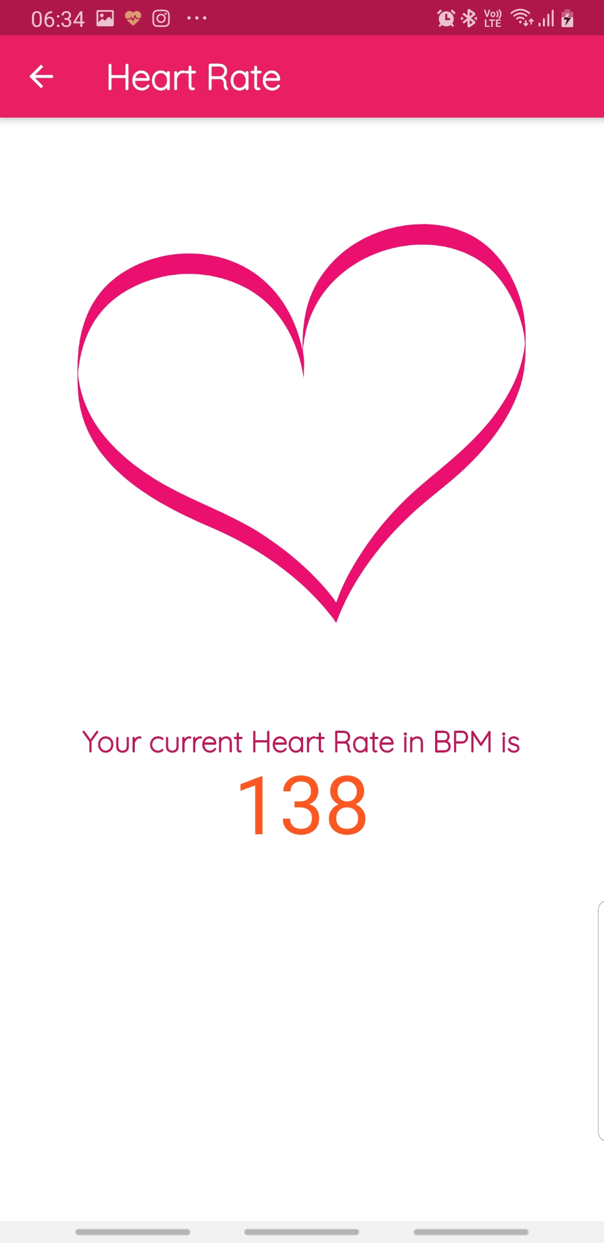
How does it work?
Software- Flutter App available for all platforms including desktops
Developed as a smart portal for end-users and Monitoring groups integrated with other health related features such as BMI Calculator or Covid guidelines

Slide 7


Technology Stack
Flutter
ThingsSpeak API
Cloud
Arduino UNO
ESP8266 Wifi MCU
Internet of Things
Sensors

Slide 8


Why RAHAT?
The current health monitoring systems are not Portable.
Most Individuals don't understand Analog Data that well
Other options are Complex system and difficult to operate
Cross Platform App
User need not buy the hardware at all. They can rent it from Hospitals and Clinics.
No Infrastructure required
Preventing over-crowding at hospitals and clinics
Much cheaper alternative than booking a bed in Hospital
Easy To Use User Interface

Slide 9
BUSINESS IDEA
RAHAT as a business
TARGET AUDIENCE
BUDGET
Health Over Money. Hardware will be available in healthcare centers/hospitals/clinics/covid camps from where patients can rent it. There will be a provision for buying the product in case user wish to.
Anyone who is in home isolation/away from healthcare services/not financially good/ living alone
PUBLICITY
FEASABILITY AND USAGE
Google ad services & Social Media Influencers to promote our product. Many International/National/State/University Level programs have been launched in support of Healthcare currently. We plan to use this opportunity to get support from such programs.
Rahat is a Health support app, created to monitor a user's health. It helps to connect directly to Specialist or loved ones who can help the user in need.

Slide 10


Motive Behind RAHAT
It's simply not possible to allocate every sick person a bed in hospital as:
It's expensive
Increases load on healthcare system
Many people are alone and don't have relatives to look after them
Healthcare infrastructure is hardly available in rural areas
Extremely difficult to keep track of patients details 24 X 7

Slide 11
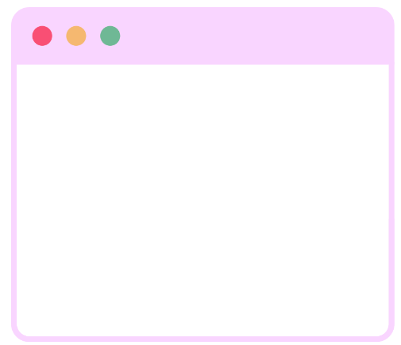
Current Features Of RAHAT
Live Heart Rate Tracking
Live Temperature Tracking
Cross Platform App ( Available on Android, iOS, Desktop & Web)
Beautiful User Interface
COVID-19 Guidelines
BMI Calculator
BMI Interpretation Message
Complete Data Storage in Cloud

Slide 12


Future Updates
RAHAT is in it's initial development phase right now. We plan to introduce the following features in newer versions.
Firebase OAuth
Multi-Lingual Support
Covid 19 Live Tracking(total, infected, dead, recovered)
Using Accelerometer of smartphone or RAHAT Band to detect fall( for dementia or narcolepsy patients)
Guides on how to perform emergency procedures such as CPR or Heimlich maneuver
Adding Comprehensive Exercise Plans
Medicine Tracker
Dark Theme

Slide 13
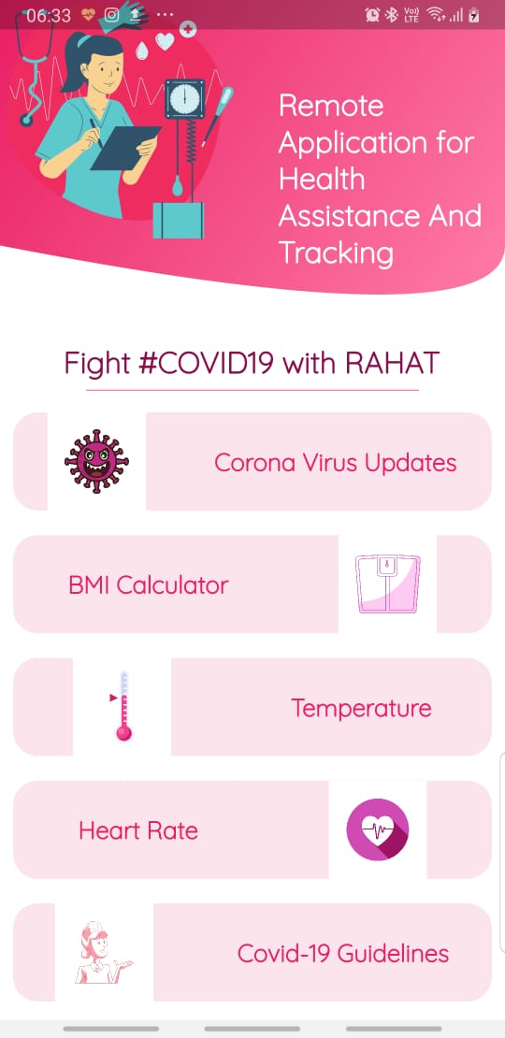
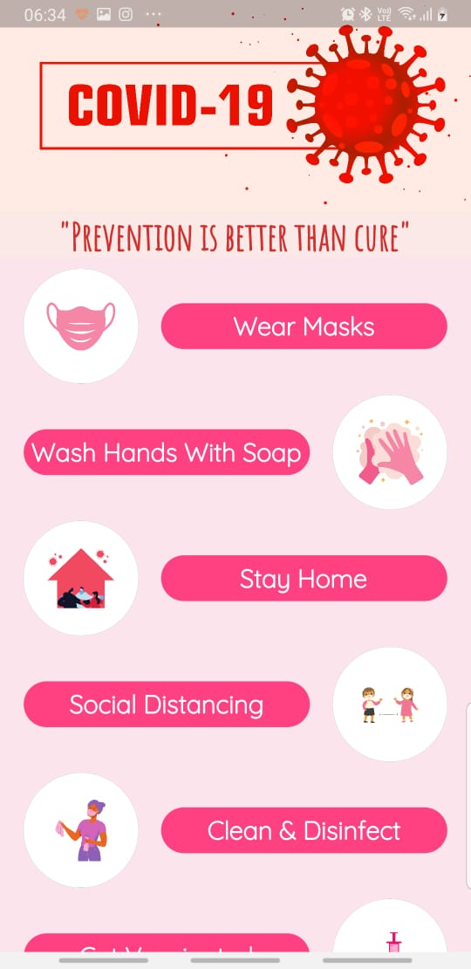

Photo Shoot

Slide 14
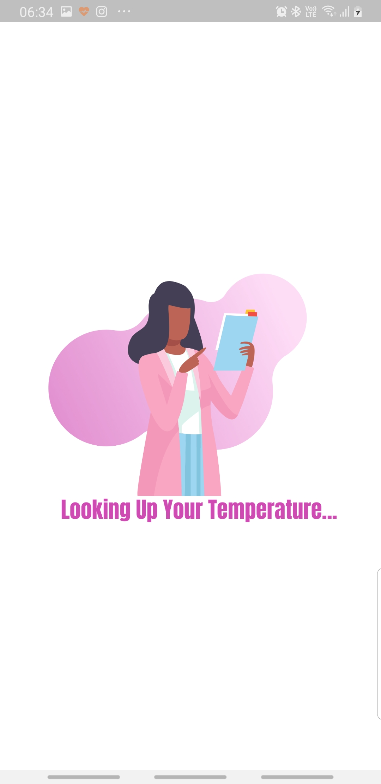
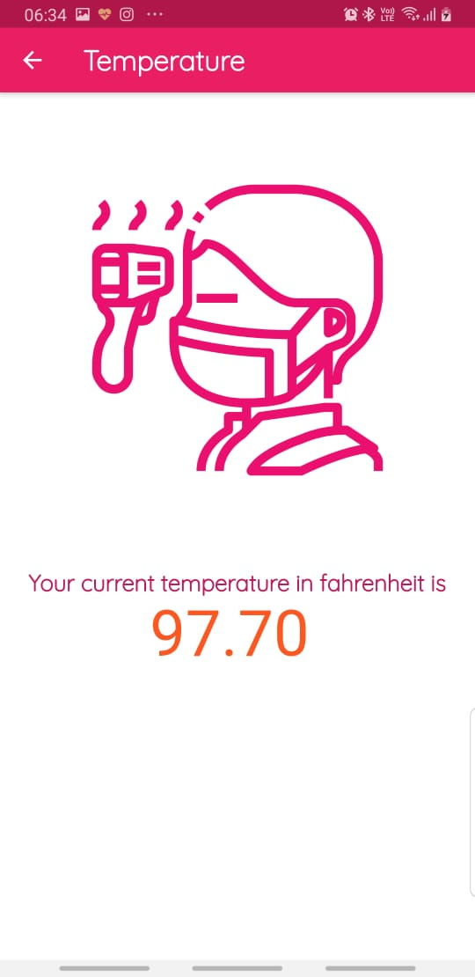
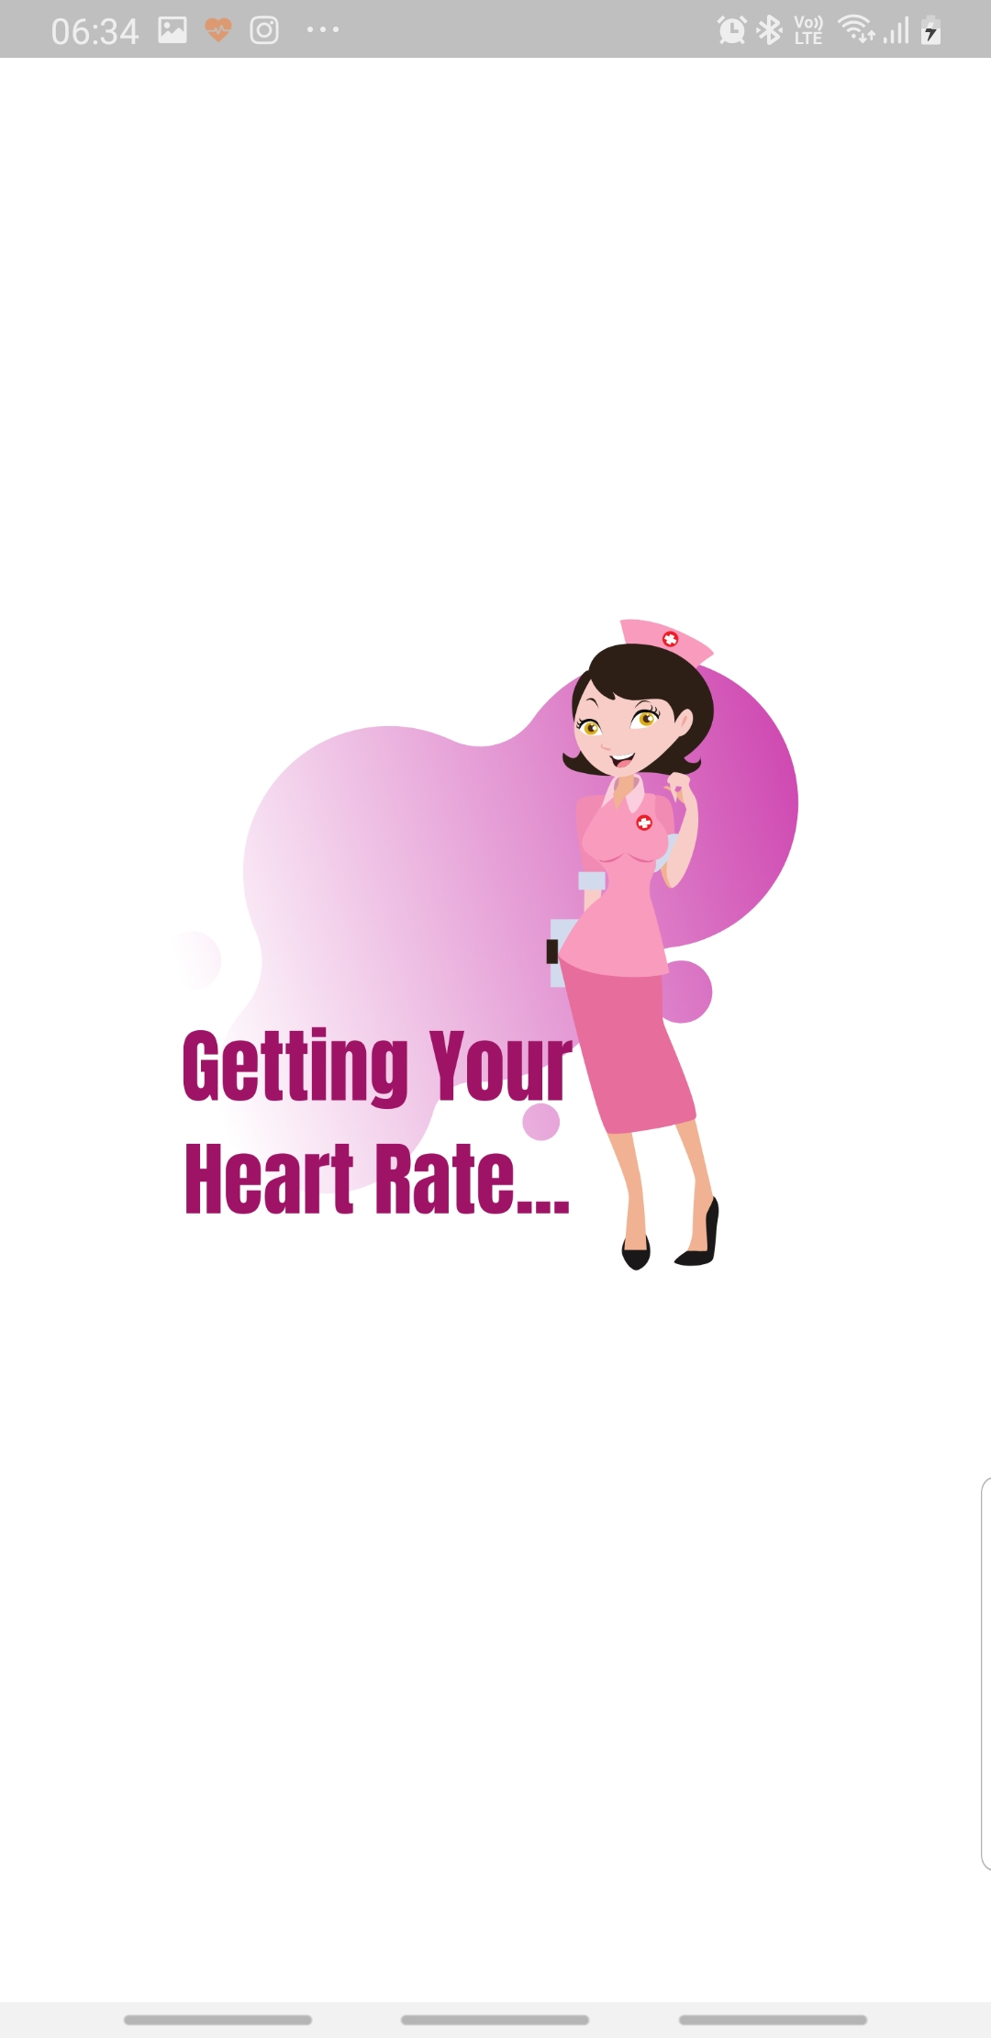

Slide 15
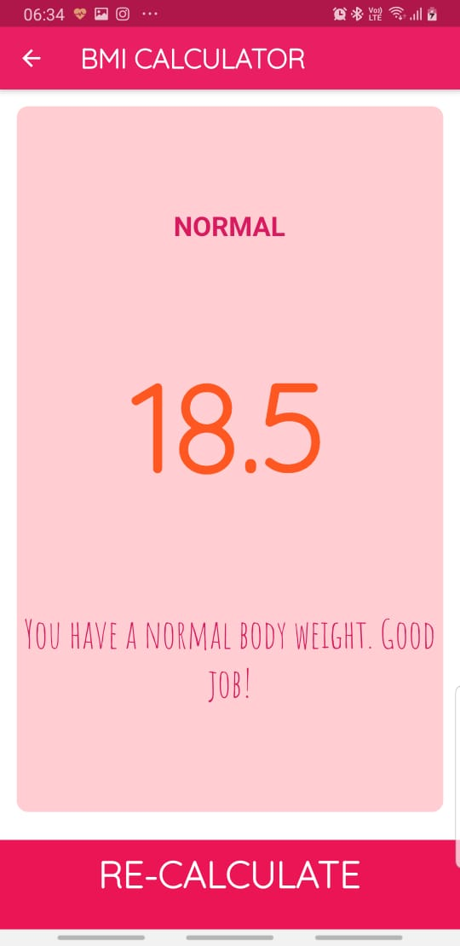
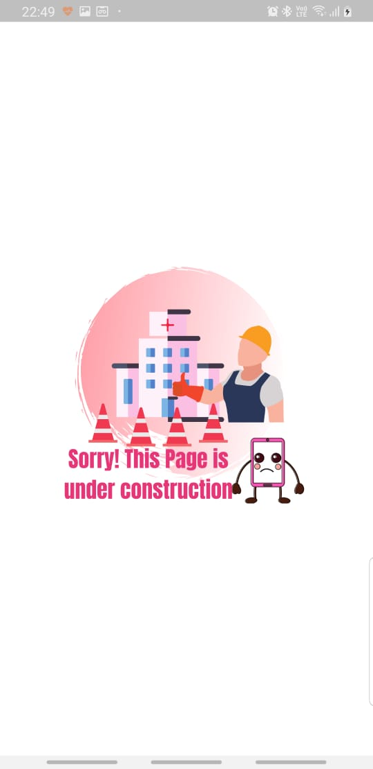
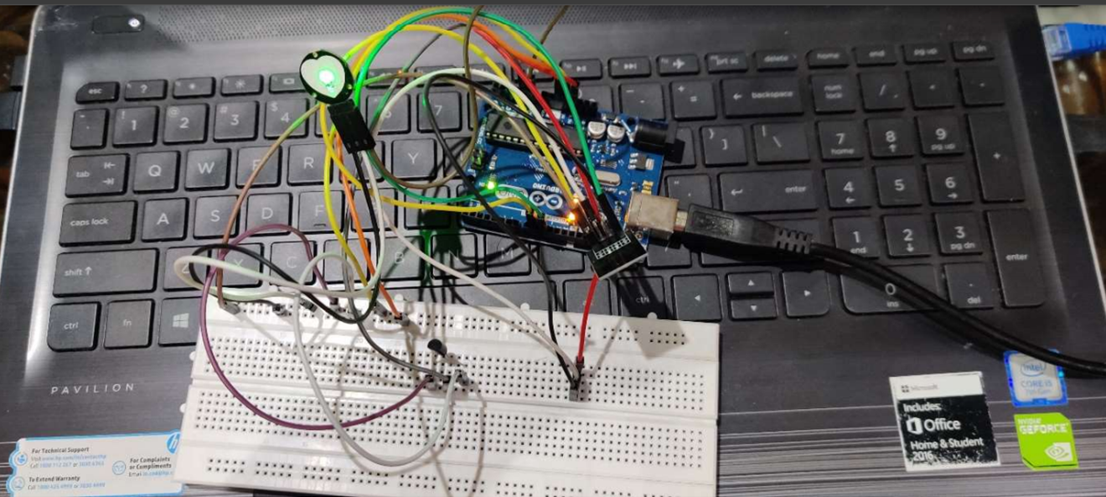

Slide 16
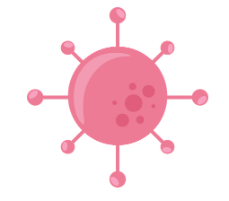




THANK YOU !
Click Here for Demo Video

